Slide 1
OPERATING SYSTEMS (CS F372) Introduction
Barsha Mitra
CSIS Dept., BITS Pilani, Hyderabad Campus

Slide 2
Why should we study OS??
How do you interact with the hardware?
What happens when a program runs?
How are the processors used?
What happens when you have parallelism?
What if multiple processes want the same resource?
What if processes want resources which are already given to other processes?
How do you manage the RAM? How do you allocate memory?
Can you run a program having size 4 GB on a system with 2 GB RAM?
What happens when you create files and organize them?
What happens when you access files?
Hands-on experience

Slide 3
Handout Overview
Text Book:
T1. Silberschatz, Galvin, and Gagne, “Operating System Concepts”, 9th edition, John Wiley & Sons, 2012.
Reference Books:
R1. W. Stallings, “Operating Systems: Internals and Design Principles”, 6th edition, Pearson, 2009.
R2. Tanenbaum, Woodhull, “Operating Systems Design & Implementation”, 3rd edition, Pearson, 2006.
R3. Dhamdhere, “Operating Systems: A Concept based Approach”, 2nd edition, McGrawHill, 2009.
R4. Robert Love, “Linux Kernel Development”, 3rd edition, Pearson, 2010.

Slide 4
Handout Overview
Reference Books:
R5. Russ Cox, Frans Kaashoek, Robert Morris, “xv6 a simple, Unix-like teaching operating system”. Online Draft, 2021. https://pdos.csail.mit.edu/6.828/2021/xv6/book-riscv-rev2.pdf
R6. Daniel P. Bovet, Marco Cesati “Understanding the Linux Kernel”, 3rd Edition.
R7. Jonathan Corbet, Alessandro Rubini, Greg Kroah-Hartman “Linux Device Drivers”, 3rd Edition.

Slide 5
Topics to be covered
Introduction
OS Structures
Processes
Threads
CPU Scheduling
Process Synchronization
Deadlocks
Main Memory Management
Virtual Memory
Mass Storage File System Interface
File System Implementation
I/O Systems
Protection

Slide 6
Evaluation
Component | Duration | Weightage (%) | Date & Time | Nature of Component
Mid Semester Examination | 90 minutes | 35% | As per Time Table | Closed Book
Assignment (2 Nos.) | Take Home | 25% | TBA | Open Book
Comprehensive Examination | 120 minutes | 40% | As per Time Table | Closed Book

Slide 7
Handout Overview
Chamber Consultation – Tuesdays 3 pm to 3:50 pm
Notices
Make-up Policy

Slide 8
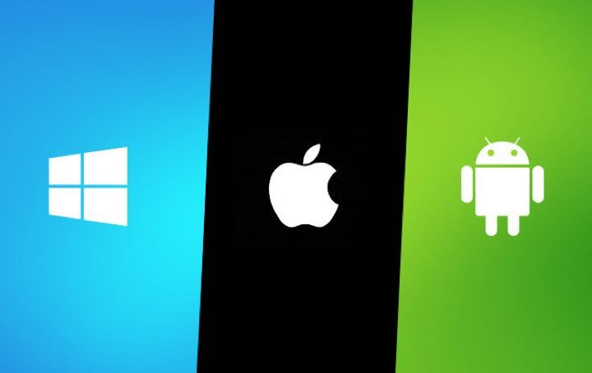
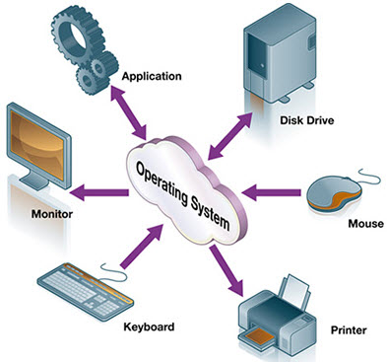
What is an Operating System

Slide 9
Introduction
program that manages computer’s hardware
acts as an intermediary between computer user and computer h/w
Types
mainframe operating systems
personal computer (PC) operating systems
operating systems for mobiles

Slide 10
Computer System Architecture
Hardware – provides basic computing resources
CPU, memory, storage, I/O devices
Operating system
Controls and coordinates use of hardware among various applications and users
Application programs – solve computing problems of users
word processors, email, web browsers, database systems, video games, media player
Users
People, machines, other computers

Slide 11
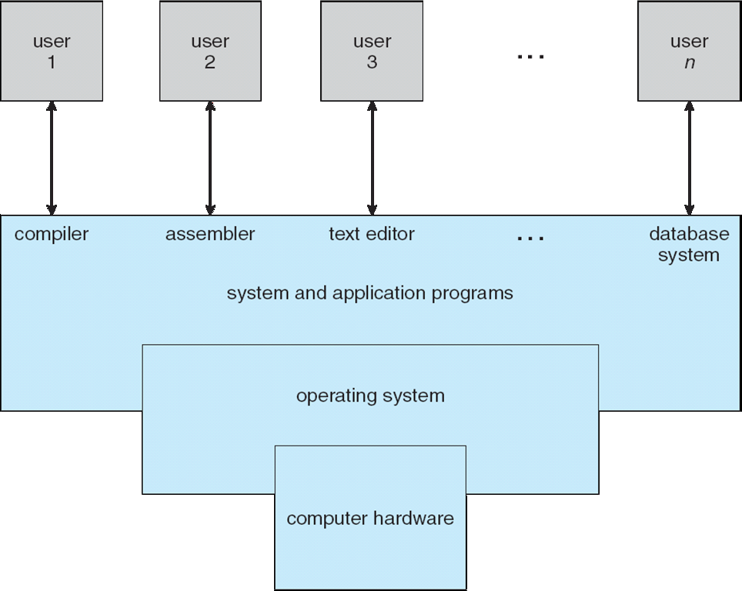
Computer System Architecture

Slide 12
What OS Does? : User View
Users want convenience, ease of use and good performance
Don’t care about resource utilization
Shared computer such as mainframe/minicomputer must keep all users happy
Dedicated systems like workstations have dedicated resources, also use shared resources from servers
Handheld computers are resource poor, optimized for individual usability and battery life
Some computers have little or no user interface, such as embedded computers in devices and automobiles

Slide 13
What OS Does? : System View
OS is a resource allocator
Manages all resources
Decides between conflicting requests for efficient and fair resource use
OS is a control program
Controls execution of user programs
Prevent errors and improper use of computer

Slide 14
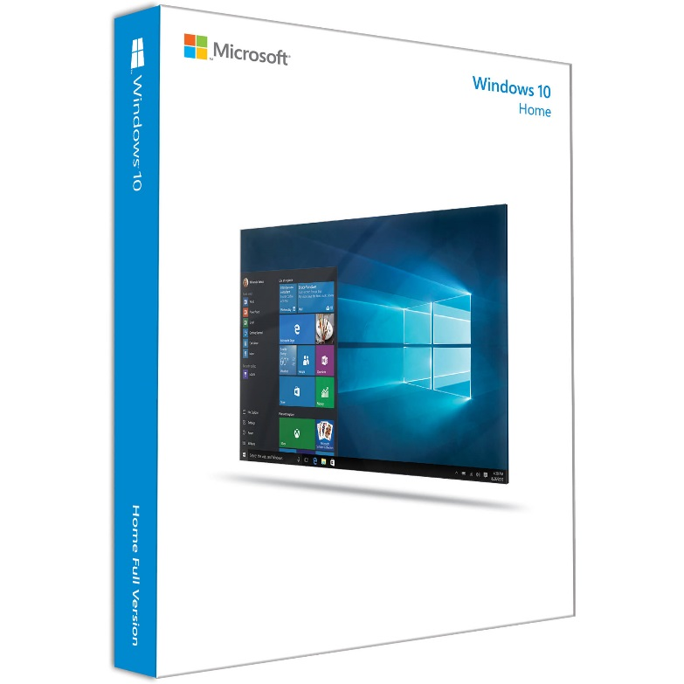
How do we define OS?
Everything a vendor ships when you order an operating system
“The one program running at all times on the computer”

Slide 15
Computer System Organization
COMPUTER SYSTEM
SOFTWARE
APPLICATION SOFTWARE
SYSTEM SOFTWARE
HARDWARE
INPUT DEVICE
CPU
OUTPUT DEVICE
OPERATING SYSTEM
UTILITY SOFTWARE
DEVICE DRIVER
SECONDARY STORAGE
ALU
MEMORY UNIT
CONTROL UNIT
PRIMARY MEMORY

Slide 16
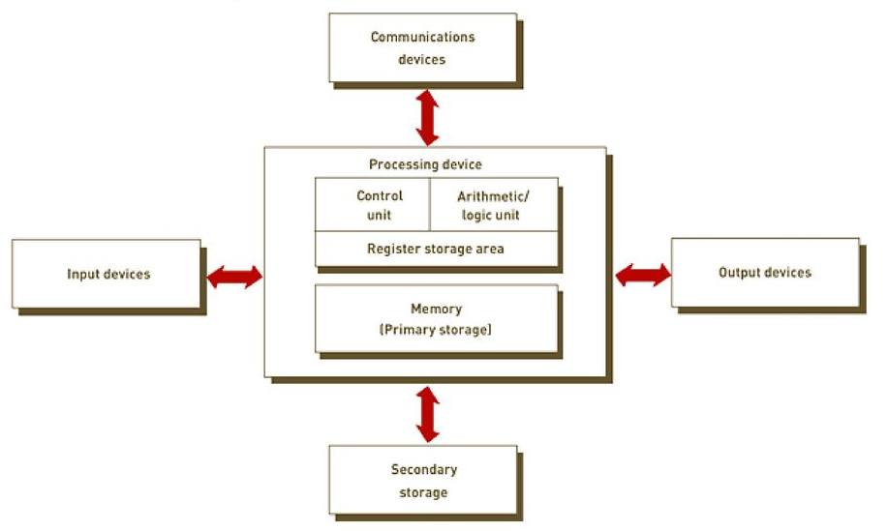
Computer-System Organization
Source: https://slideplayer.com/slide/11959410/

Slide 17
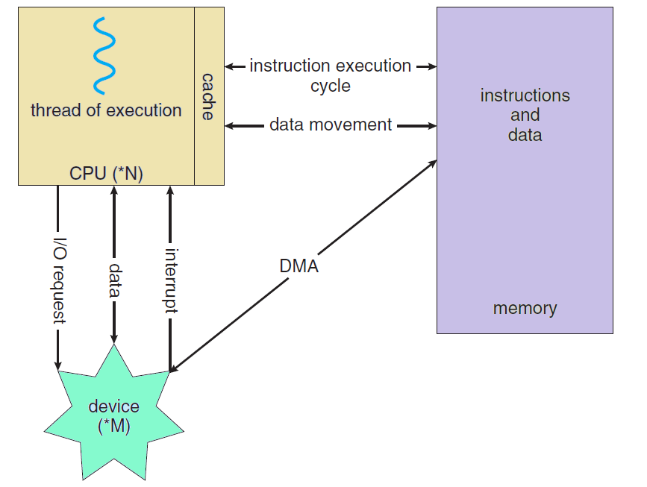
Putting it All Together

Slide 18
OS vs. Kernel
Disk Management
Memory Management
Process Management
Task Management
OS
KERNEL
DEVICE DRIVERS
UTILITIES
SYSTEM LIBRARIES
USER INTERFACE
https://www.geeksforgeeks.org/difference-between-operating-system-and-kernel/
https://www.gnu.org/gnu/linux-and-gnu.html#:~:text=Linux%20is%20the%20kernel%3A%20the,of%20a%20complete%20operating%20system.
https://www.tutorialspoint.com/difference-between-operating-system-and-kernel

Slide 19
Computer-System Operation
Bootstrap program is loaded at power-up or reboot
initial program
stored in ROM or EEPROM
generally known as firmware
initializes all aspects of system like CPU registers, device controllers, memory contents
locates and loads operating system kernel and starts execution

Slide 20
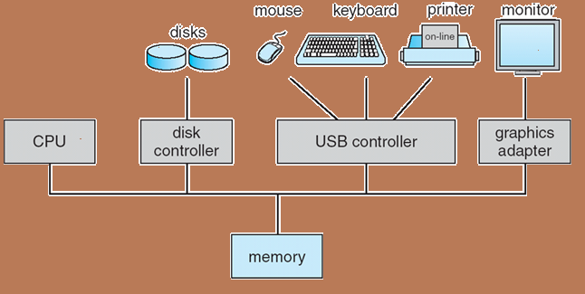
Computer System Operation
Computer-system operation
One or more CPUs, device controllers connect through common bus providing access to shared memory
Concurrent execution of CPUs and devices competing for memory cycles
device controller is a hardware component that works as a bridge between the hardware device and the operating system or an application program

Slide 21
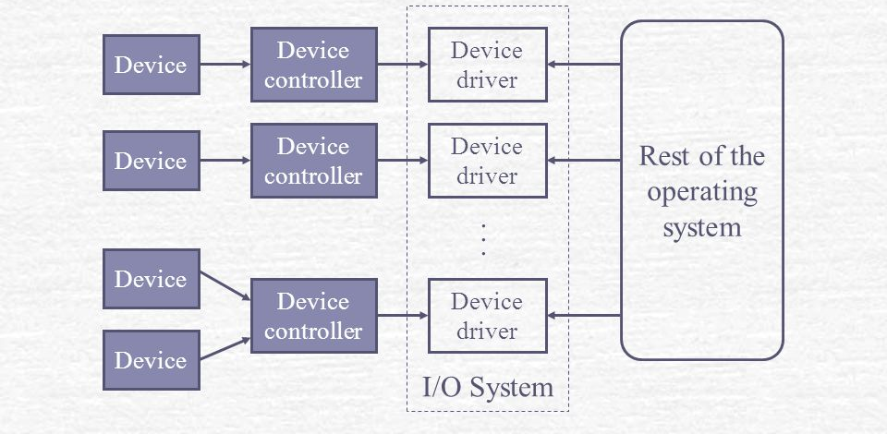
Computer-System Operation
device controller
maintains some local buffer storage and a set of special-purpose registers
moves data between the devices that it controls and its local buffer storage
operating systems have a device driver for each device controller
device driver
understands the device controller
provides the rest of the OS with a uniform interface to the device

Slide 22
Computer-System Operation
I/O devices and the CPU can execute concurrently
Each device controller has a local buffer
CPU moves data from/to main memory to/from local buffers
I/O is from the device to local buffer of controller
Device controller informs CPU that it has finished its operation by causing an interrupt

Slide 23
Interrupt Handling
Sequential program execution by CPU
IVT - table of pointers containing addresses of all service routines
Control transfer to ISR
Execute ISR
Examine Interrupt Vector Table (IVT)
Interrupt received
Save contents of CPU registers & PC on system stack
Control returns to interrupted program

Slide 24
Types of Interrupts
Interrupts
Hardware Interrupts
Maskable
Non-maskable
Software Interrupts
Normal
Exception/Trap

Slide 25
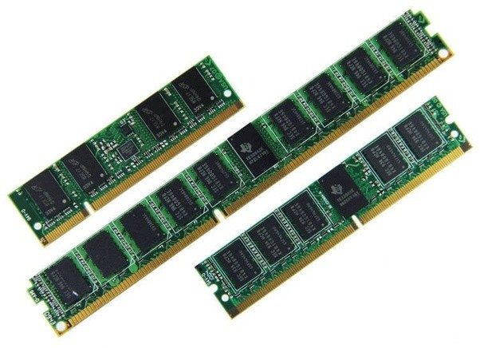
Storage Structure
Main memory –
only storage media that the CPU can access directly
instruction execution
random access
volatile

Slide 26
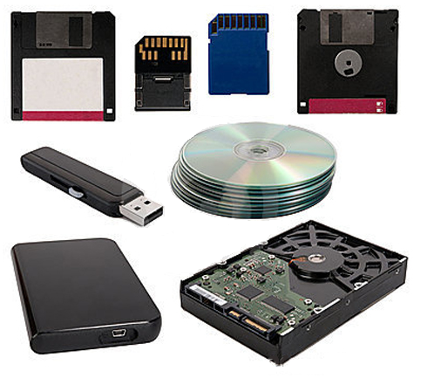
Storage Structure
Secondary storage –
provides large nonvolatile storage capacity
stores both program and data

Slide 27
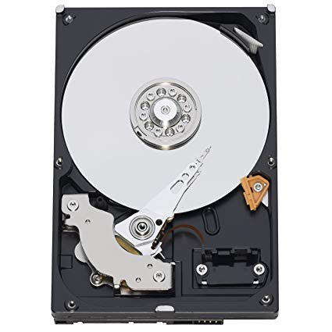
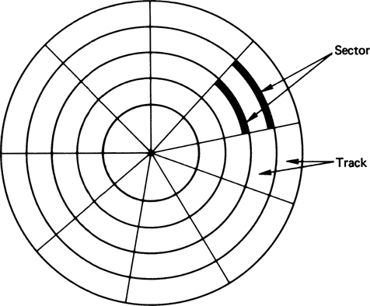
Storage Structure
Hard disks/Magnetic disks –
rigid metal or glass platters covered with magnetic recording material
disk surface is logically divided into tracks, which are subdivided into sectors
disk controller determines the interaction between the device and the computer

Slide 28
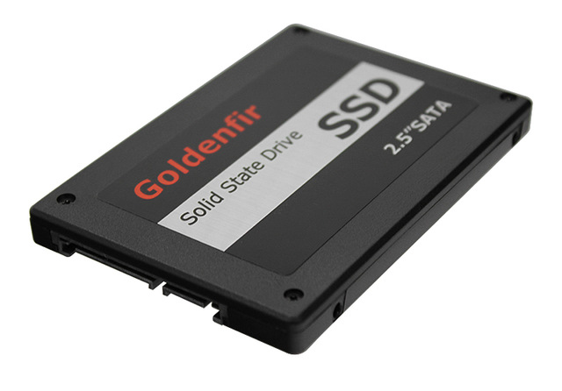
Storage Structure
Solid-state disks –
faster than magnetic disks, nonvolatile
becoming more popular

Slide 29
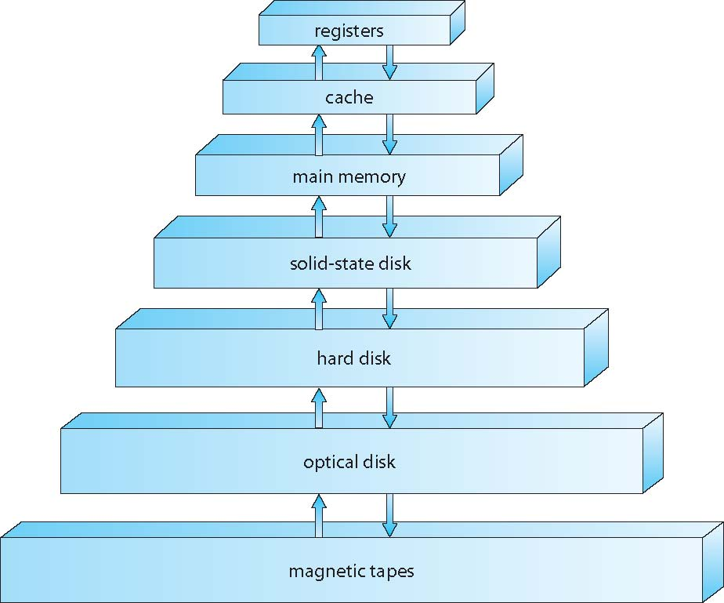
Storage Structure

Slide 30
I/O Operation
device driver loads registers within device controller
device controller examines registers’ contents to determine what action to take
controller starts transfer of data from the device to its local buffer
device controller informs the device driver via an interrupt that it has finished its operation
device driver returns control to OS

Slide 31
I/O Structure
device controller transfers an entire block of data directly to or from its own buffer storage to memory
no intervention by CPU
only one interrupt is generated per block, to tell the device driver that the operation has completed
no interrupt per byte generated
CPU is available to accomplish other work
interrupt-driven I/O
moving small amounts of data
can produce high overhead for bulk data movement such as disk I/O
direct memory access (DMA)

Slide 32
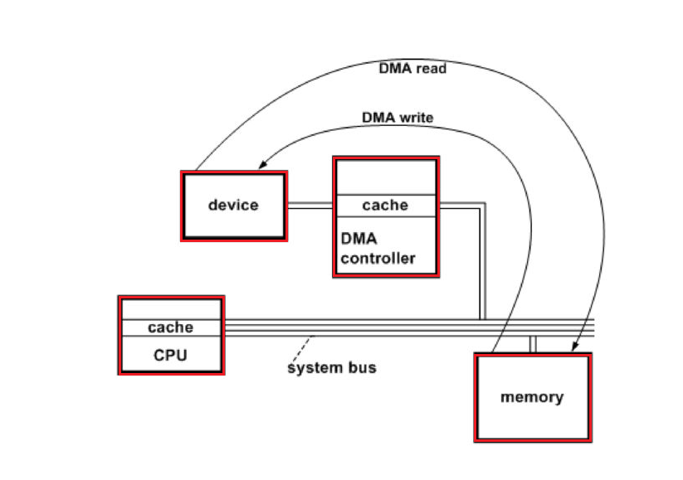
I/O Structure

Slide 33
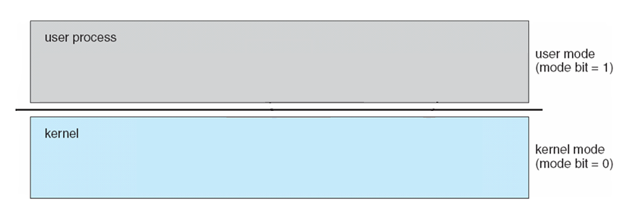






Operating System Operations
Dual-mode operation allows OS to protect itself and protect users from one another
User mode and Kernel/Supervisor/System/Privileged mode
Mode bit provided by hardware
Provides ability to distinguish when system is running user code or kernel code
Some instructions designated as privileged, only executable in kernel mode
System call changes mode to kernel, return from call resets it to user
locate ISR via interrupt vector and excecute

Slide 34
Operating System Operations
Boot time → hardware starts in kernel mode
After loading OS, user applications are started in user mode
When trap/interrupt occurs, hardware switches from user mode to kernel mode
examples of privileged instructions – switch to kernel mode, I/O control, timer management, interrupt management

Slide 35
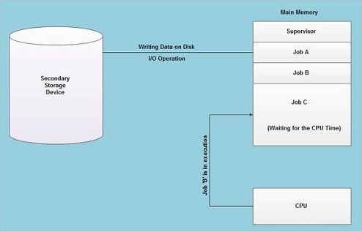
Multiprogramming (Batch system)
Job Pool

Slide 36
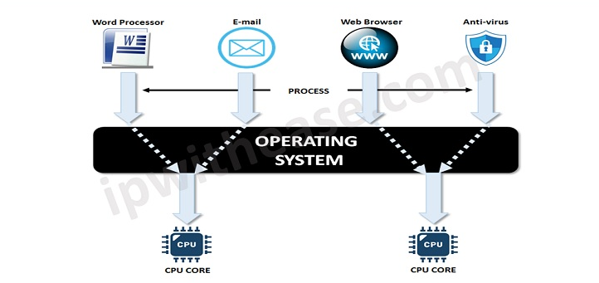
Multitasking
Source: https://networkinterview.com/time-sharing-and-multi-tasking/

Slide 37
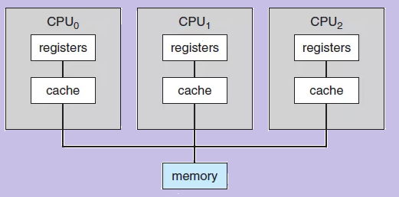
Computing Environments
Multiprocessor Systems

Slide 38
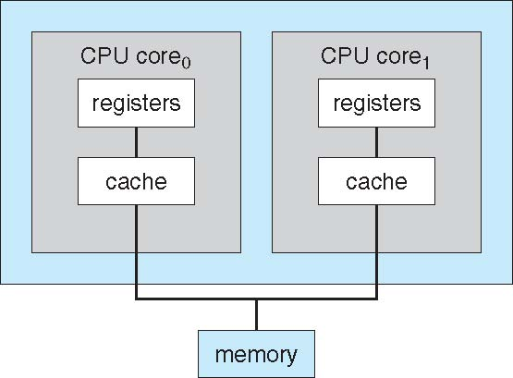
Computing Environments
Multicore Systems
dual-core design with both cores on same chip

Slide 39
Thank You

